Slide 1
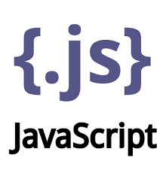

Front End Development Framework
Course Coordinator: Dr. Y Subbarayudu

Slide 2


JavaScript Essentials
Q1. What are Variables? What is the difference between var, let, and const ?
Q2. What are the Types of Conditions statements in JS?
Q3. What is Error Handling in JS?
Q4. What is the difference between Spread and Rest operator in JS?
Q5. What are Arrays in JS? How to get, add & remove elements from arrays?
Q6. What is Array Destructuring in JS?
Q7. What are Functions in JS? What are the types of function?
Q8. Difference between Named and Anonymous functions? When to use what?
Q9. What is Function Expression in JS?
Q10. What are Arrow Functions in JS? What is it use?
Q11. What are Callback Functions? What is it use?
Q12. What is Higher-order function In JS?
Q13. What are Pure and Impure functions in JS?
Back to main index

Slide 3
JavaScript Essentials
Q14. What are template literals and string interpolation in strings?
Q15. What are Objects in JS?
Q16. What is the difference between an array and an object?
Q17. How do you add or modify or delete properties of an object?
Q18. What is asynchronous programming in JS? What is its use?
Q19. What is the difference between synchronous and asynchronous programming?
Q20. What are Promises in JavaScript?
Q21. How to implement Promises in JavaScript?
Q22. What is the purpose of async/ await? Compare it with Promises?
Q23. What are Classes in JS?
Q24. What is a Constructor?
Q25. What is the use of this keyword?
Back to main index

Slide 4


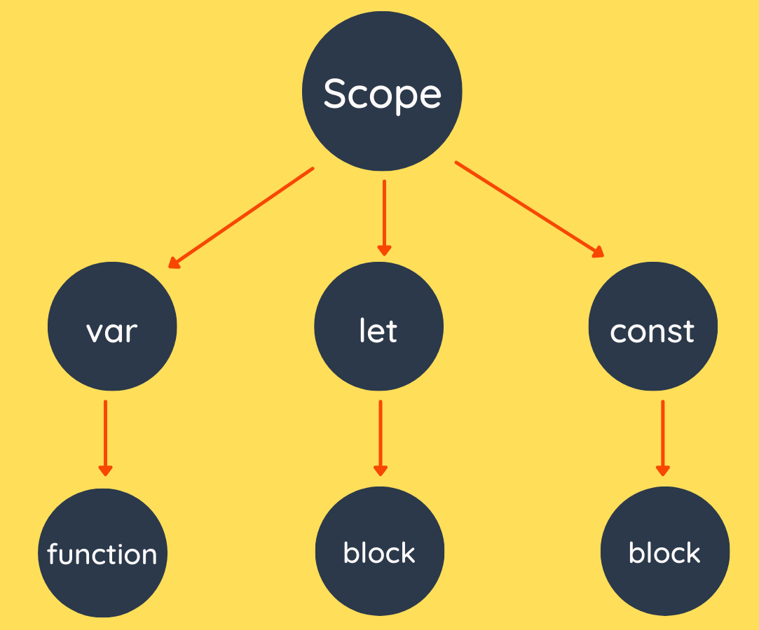
Q. What are variables? What is the difference between var, let, and const ?
Variables are used to store data.
back to chapter index

Slide 5
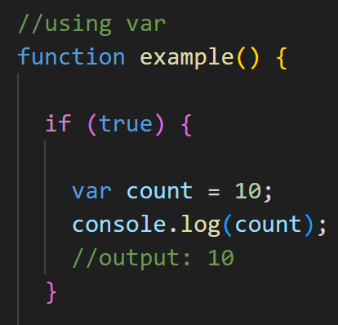
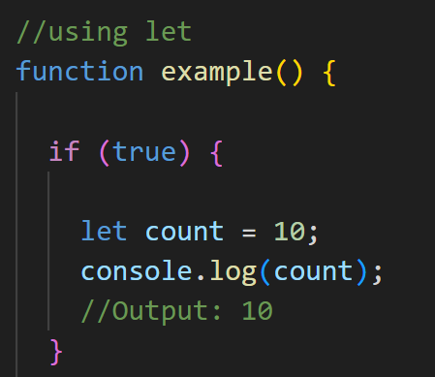
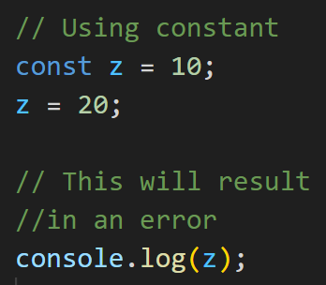
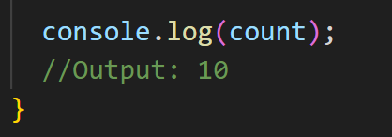
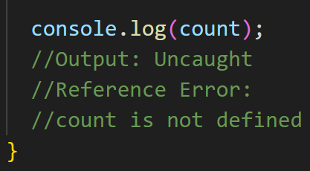
Q. What are variables? What is the difference between var, let, and const ?
var creates a function-scoped variable.
let creates a block-scoped variable
const can be assigned only once, and its value cannot be changed afterwards.
back to chapter index

Slide 6
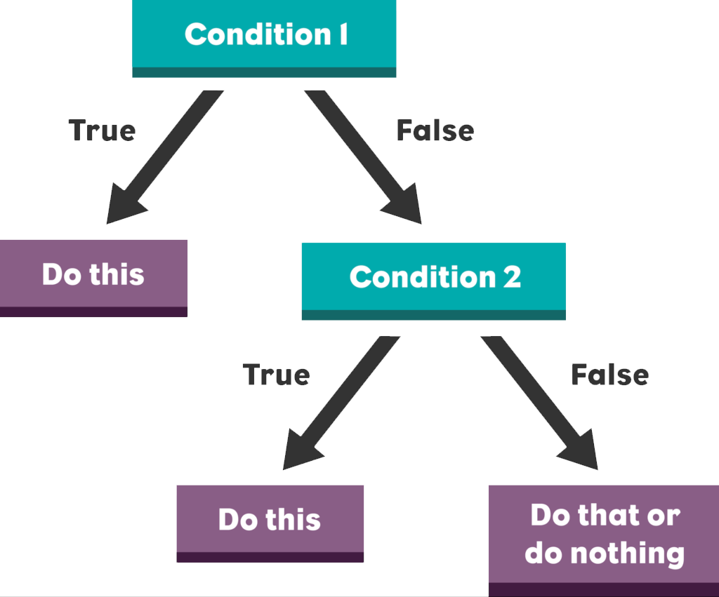
Q. What are the types of conditions statements in JS?
back to chapter index

Slide 7
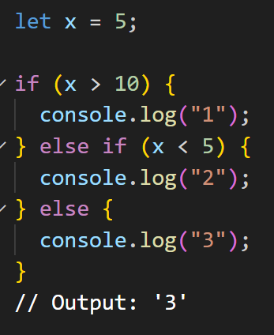
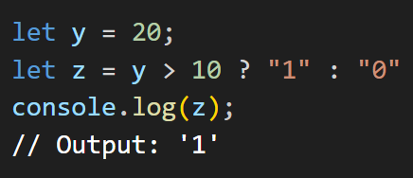
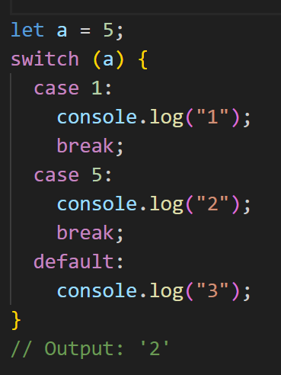
Q. What are the types of conditions statements in JS?
Types of condition statements
2. Ternary operator
1. If/ else statements
3. Switch statement
back to chapter index
Notes:
let x = 5;
if (x > 10) {
console.log("1");
} else if (x < 5) {
console.log("2");
} else {
console.log("3");
}
// Output: '3'
let y = 20;
let z = y > 10 ? "1" : "0"
console.log(z);
// Output: '1'
let a = 5
switch (a) {
case 1:
console.log("1");
break;
case 5:
console.log("2");
break;
default:
console.log("3");
}
// Output: '2'

Slide 8
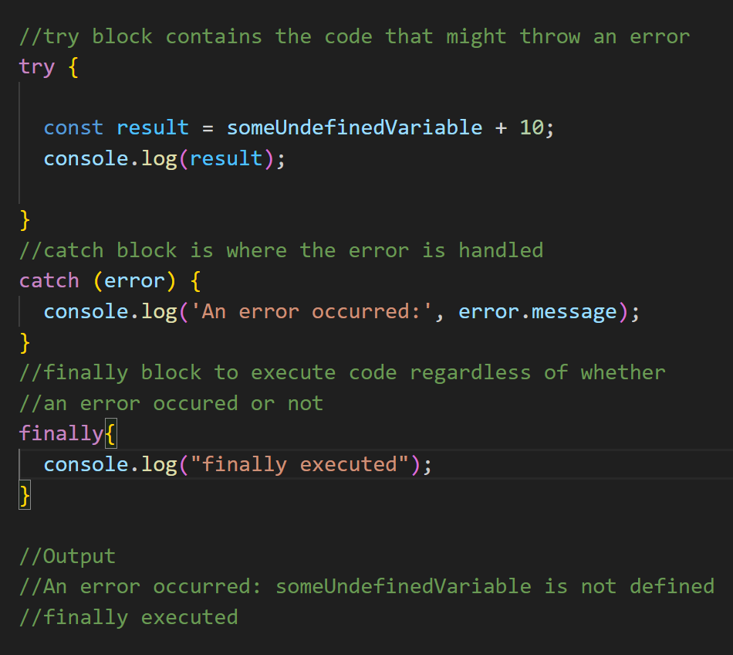
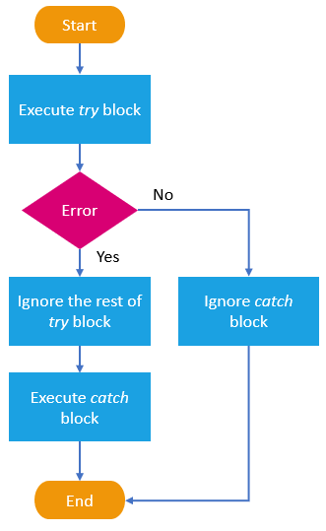
Q. What is Error Handling in JS?
Error handling is the process of managing errors.
back to chapter index
Notes:
//try block contains the code that might throw an error
try {
const result = someUndefinedVariable + 10;
console.log(result);
}
//catch block is where the error is handled
catch (error) {
console.log('An error occurred:', error.message);
}
//finally block to execute code regardless of whether
//an error occured or not
finally{
console.log("finally executed");
}
//Output
//An error occurred: someUndefinedVariable is not defined
//finally executed

Slide 9
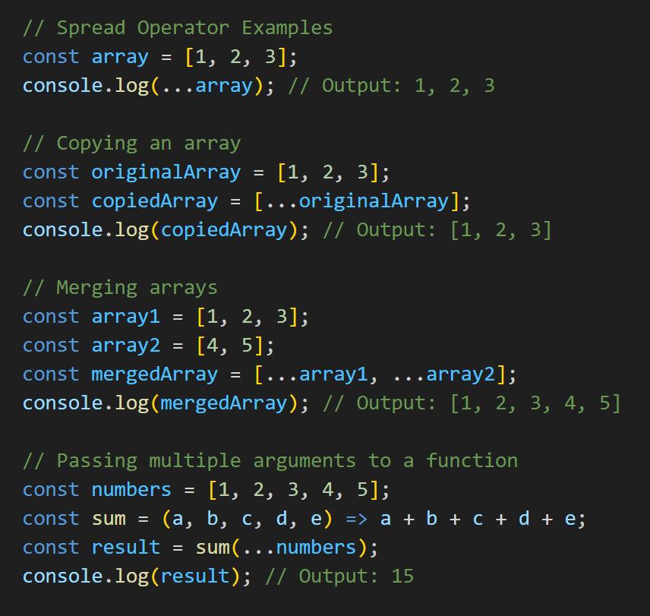
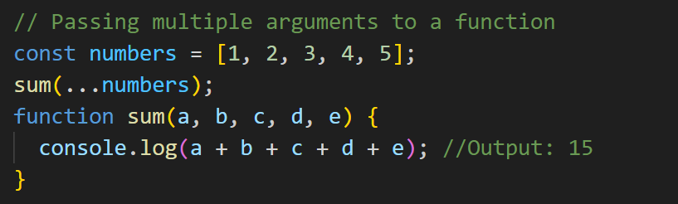
Q. What is the difference between Spread and Rest operator in JS?
The spread operator(...) is used to expand or spread elements from an iterable (such as an array, string, or object) into individual elements.
Uses of Spread Operator
Merging Arrays
Copying an Array
Passing Multiple Arguments to a Function
back to chapter index
Notes:
// Spread Operator Examples
const array = [1, 2, 3];
console.log(...array); // Output: 1, 2, 3
// Copying an array
const originalArray = [1, 2, 3];
const copiedArray = [...originalArray];
console.log(copiedArray); // Output: [1, 2, 3]
// Merging arrays
const array1 = [1, 2, 3];
const array2 = [4, 5];
const mergedArray = [...array1, ...array2];
console.log(mergedArray); // Output: [1, 2, 3, 4, 5]
// Passing multiple arguments to a function
const numbers = [1, 2, 3, 4, 5];
const sum = (a, b, c, d, e) => a + b + c + d + e;
const result = sum(...numbers);
console.log(result); // Output: 15

Slide 10
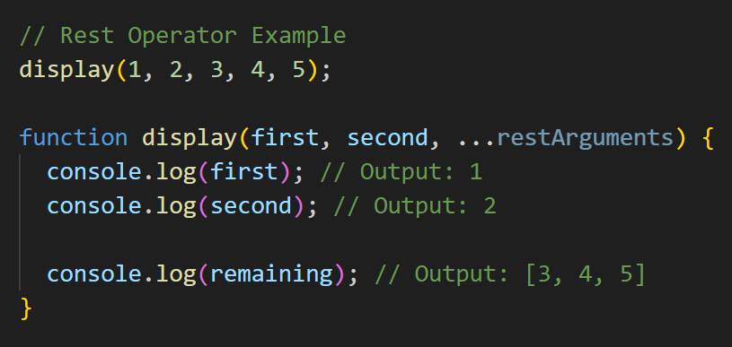
Q. What is the difference between Spread and Rest operator in JS?
The rest operator is used in function parameters to collect all remaining arguments into an array.
back to chapter index
Notes:
// Rest Operator Example
display(1, 2, 3, 4, 5);
function display(first, second, ...restArguments) {
console.log(first); // Output: 1
console.log(second); // Output: 2
console.log(remaining); // Output: [3, 4, 5]
}

Slide 11
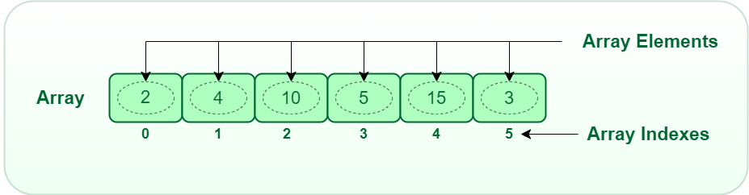
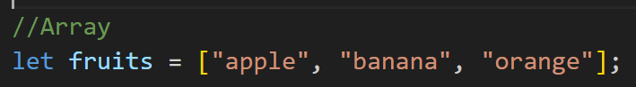
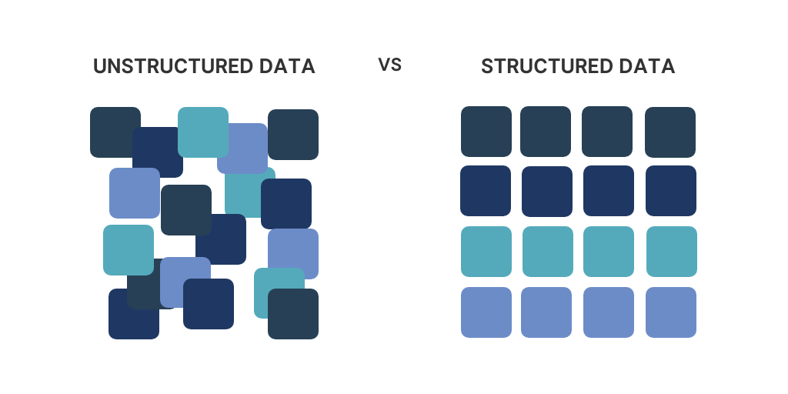
Q. What are Arrays in JS? How to get, add & remove elements from arrays?
An array is a data type that allows you to store multiple values in a single variable.
Array1
Multiple
Variables
Array2
Array3
Array4
back to chapter index

Slide 12
Q. What are Arrays in JS? How to get, add & remove elements from arrays?
Arrays methods
Get
Add
Remove
Modify
push()
concat()
pop()
shift()
splice()
indexOf()
find()
filter()
Slice()
Others
map()
forEach()
join()
length
sort()
reverse()
reduce()
some()
every()
back to chapter index

Slide 13
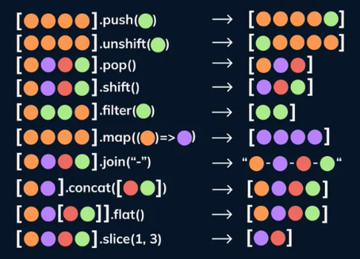
Q. What are Arrays in JS? How to get, add & remove elements from arrays?
Pictorial representation of important method of arrays
back to chapter index

Slide 14
Q. What is Array Destructuring in JS?
Array destructuring allows you to extract elements from an array and assign them to individual variables in a single statement.
Array destructuring is introduced in ECMAScript 6 (ES6).
Structuring
Array1
Multiple
Variables
Array2
Destructuring
Array3
Array4
back to chapter index
Notes:
// Example array
const fruits = ['apple', 'banana', 'orange'];
// Array destructuring
const [firstFruit, secondFruit, thirdFruit] = fruits;
// Output
console.log(firstFruit); // Output: "apple"
console.log(secondFruit); // Output: "banana"
console.log(thirdFruit); // Output: "orange"

Slide 15
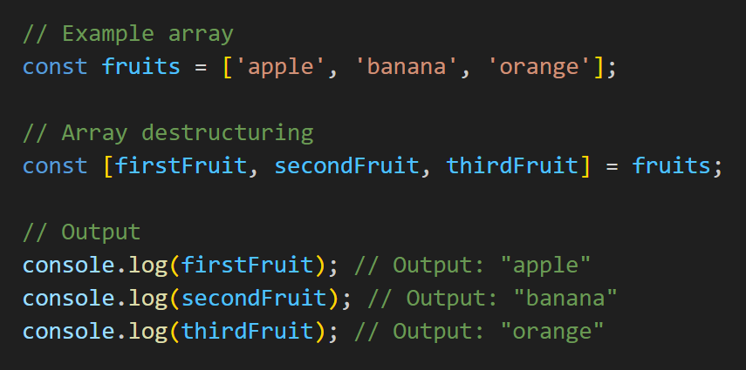
Q. What is Array Destructuring in JS?
back to chapter index
Notes:
// Example array
const fruits = ['apple', 'banana', 'orange'];
// Array destructuring
const [firstFruit, secondFruit, thirdFruit] = fruits;
// Output
console.log(firstFruit); // Output: "apple"
console.log(secondFruit); // Output: "banana"
console.log(thirdFruit); // Output: "orange"

Slide 16
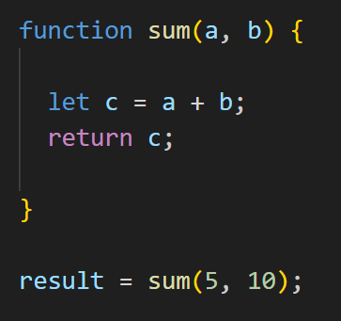
Q. What are Functions in JS? What are the types of function?
A function is a reusable block of code that performs a specific task.
Function keyword
Function name
Parameters list
Function body
Function call
Argument list
back to chapter index
Notes:
//Q. What is function in JS?
//A function is a reusable block of code that
//performs a specific task
//Function example
function sum(a, b) {
let c = a + b;
console.log(c);
}
//Call Function
sum(5, 10);
//Output: 15

Slide 17
Q. What are Functions in JS? What are the types of function?
Types of Functions
Named Function
Anonymous Function
Function Expression
Arrow Function
IIFE
Callback Function
Higher-Order Function
back to chapter index
Notes:
//Q. What is function in JS?
//A function is a reusable block of code that
//performs a specific task
//Function example
function sum(a, b) {
let c = a + b;
console.log(c);
}
//Call Function
sum(5, 10);
//Output: 15

Slide 18
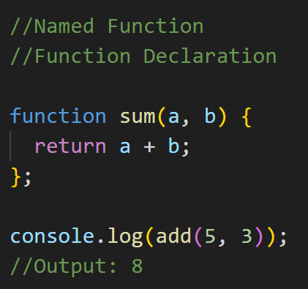
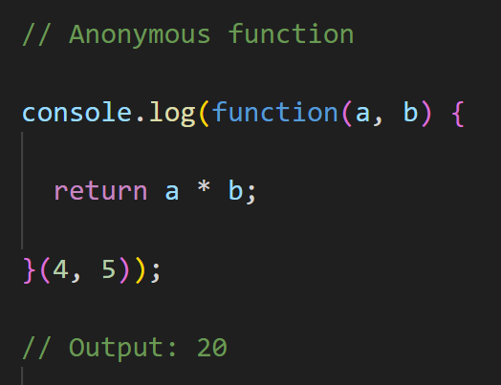
Q. What is the difference between named and anonymous functions?
When to use what in applications?
Named functions have a name identifier
Anonymous functions do not have a name identifier and cannot be referenced directly by name.
Use named functions for big and complex logics.
Use when you want to reuse one function at multiple places.
Use anonymous functions for small logics.
Use when want to use a function in a single place.
back to chapter index
Notes:
// Named function
//Function declaration
function sum(a, b) {
return a + b;
}
console.log(sum(5, 3));
// Output: 8
// Anonymous function
console.log(function(a, b) {
return a * b;
}(4, 5));
// Output: 20

Slide 19
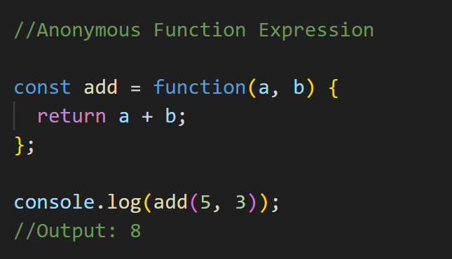
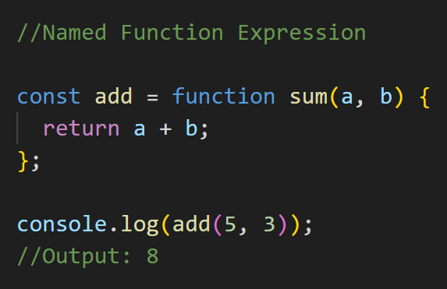
Q. What is function expression in JS?
A function expression is a way to define a function by assigning it to a variable.
back to chapter index
Notes:
// Anonymous function expression
const add = function(a, b) {
return a + b;
};
console.log(add(5, 3));
// Output: 8
// Named function expression
const addNamed = function sum(a, b) {
return a + b;
};
console.log(addNamed(5, 3));
// Output: 8

Slide 20
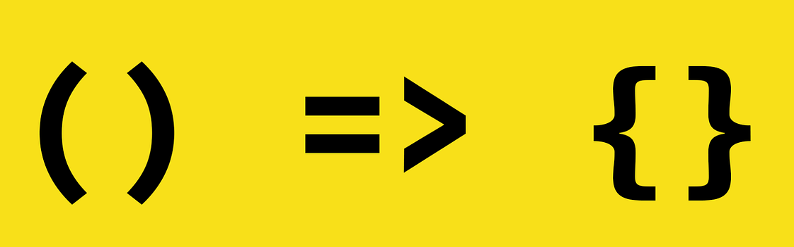
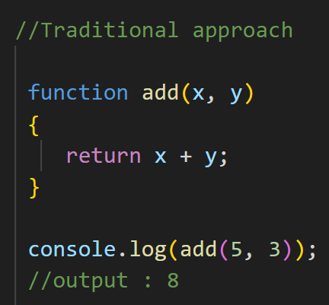
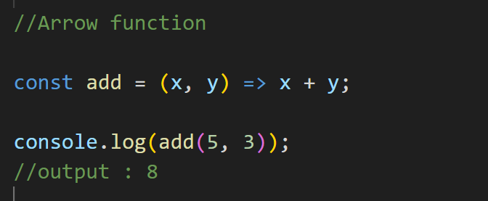
Q. What are Arrow Functions in JS? What is it use?
Arrow functions, also known as fat arrow functions, is a simpler and shorter way for defining functions in JavaScript.
Parameters list
Function body
back to chapter index
Notes:
// Traditional approach
function add(x, y)
{
return x + y;
}
console.log(add(5, 3));
// Output: 8
// Arrow function
const addArrow = (x, y) => x + y;
console.log(addArrow(5, 3));
// Output: 8

Slide 21
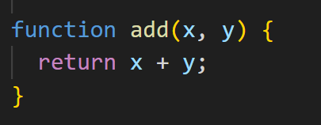
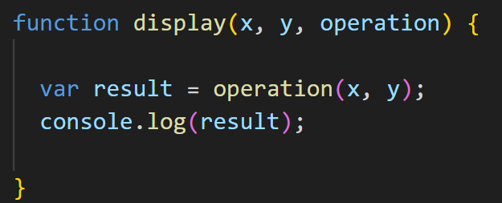
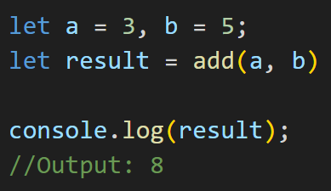

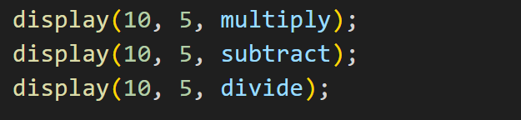
Q. What are Callback Functions? What is it use?
A callback function is a function that is passed as an argument to another function.
Higher-order function
Callback function
back to chapter index
Notes:
function add(x, y)
{
return x + y;
}
let a = 3, b = 5;
let result = add(a, b);
console.log(result);
// Output: 8
function display(x, y, operation){
var result = operation(x, y)
console.log(result);
}
display(10, 5, add);
display(10, 5, multiply);
display(10, 5, substract);
display(10, 5, divide);

Slide 22
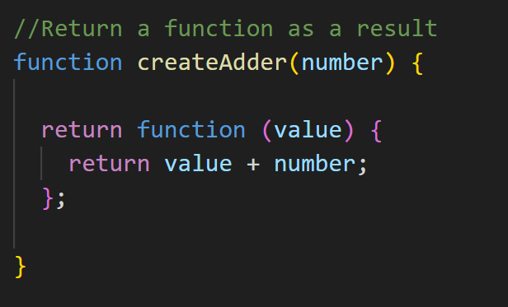
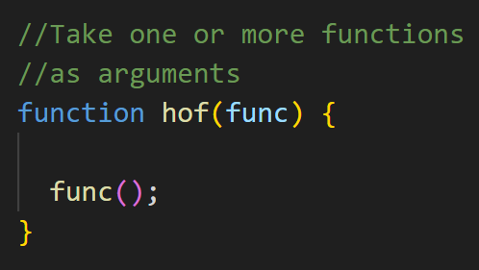

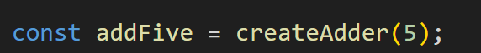
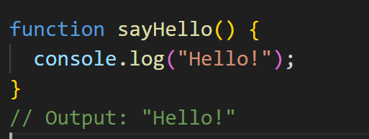
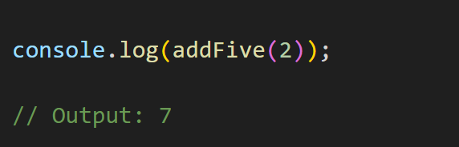
Q. What is Higher-order function In JS?
A Higher order function:
Take one or more functions as arguments(callback function) OR
Return a function as a result
Callback function
High-order function
back to chapter index

Slide 23
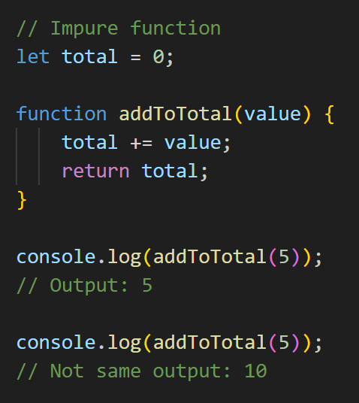
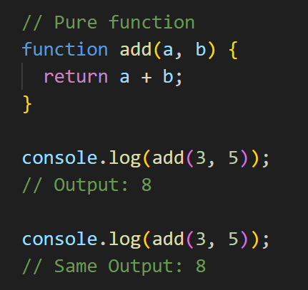
Q. What are Pure and Impure functions in JS?
A pure function is a function that always produces the same output for the same input.
Pure functions cannot modify the state.
Pure functions cannot have side effects.
An impure function, can produce different outputs for the same input.
Impure functions can modify the state.
Impure functions can have side effects.
back to chapter index
Notes:
// Pure function
function add(a, b) {
return a + b;
}
console.log(add(3, 5));
// Output: 8
console.log(add(3, 5));
// Same Output: 8
// Impure function
let total = 0;
function addToTotal(value) {
total += value;
return total;
}
console.log(addToTotal(5));
// Output: 5
console.log(addToTotal(5));
// Not same output: 10

Slide 24
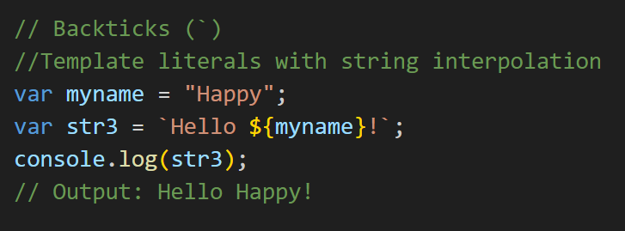

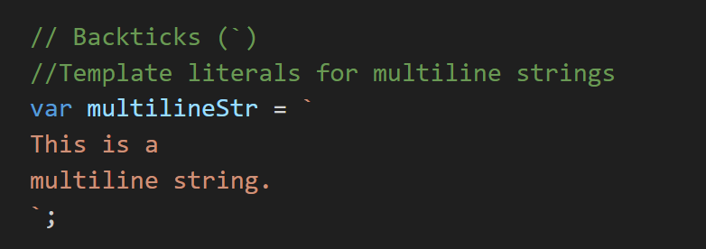
Q. What are template literals and string interpolation in strings?
A template literal, also known as a template string, is a feature introduced in ECMAScript 2015 (ES6) for string interpolation and multiline strings in JavaScript.
back to chapter index
Notes:
// Backticks (`)
//Template literals with string interpolation
var myname = "Happy";
var str3 = `Hello ${myname}!`;
// Backticks (`)
//Template literals for multiline strings
var multilineStr = `
This is a
multiline string.
`;

Slide 25
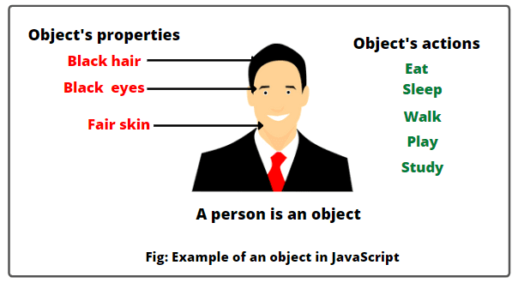
Q. What are Objects in JS?
back to chapter index

Slide 26
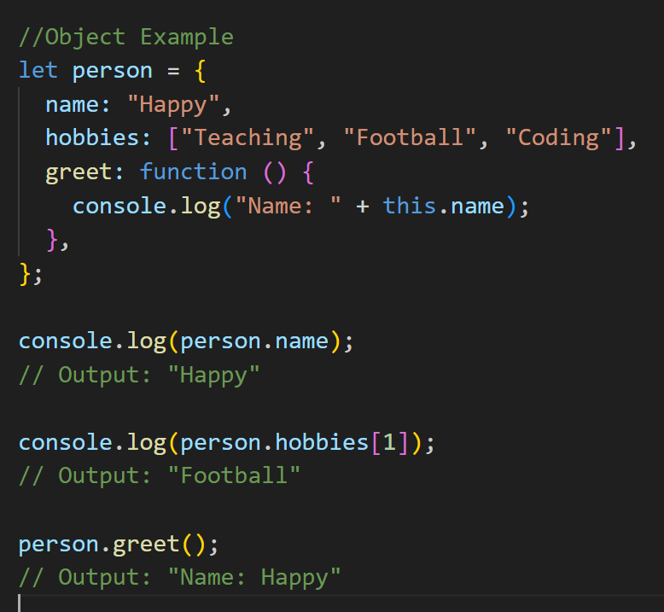
Q. What are Objects in JS?
An object is a data type that allows you to store key-value pairs.
Object
String/ number/ boolean/ null/ undefined
Array
Object
Function
back to chapter index
Notes:
//Object Example
let person = {
name: "Happy",
hobbies: ["Teaching", "Football", "Coding"],
greet: function () {
console.log("Name: " + this.name);
},
};
console.log(person.name);
// Output: "Happy"
console.log(person.hobbies[1]);
// Output: "Football"
person.greet();
// Output: "Name: Happy"

Slide 27
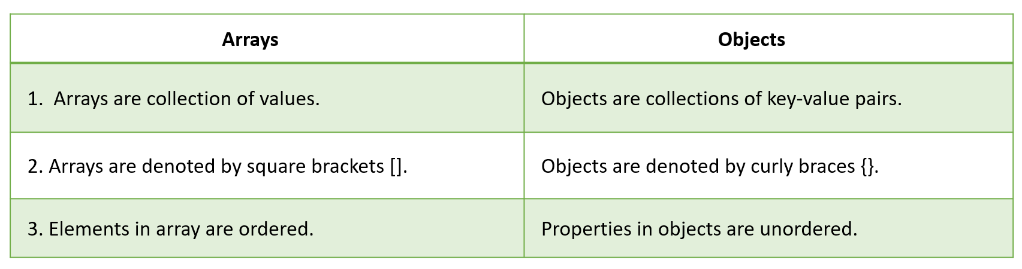
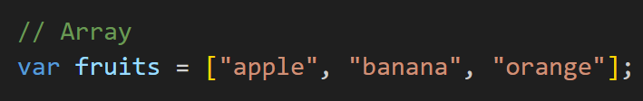
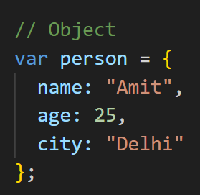
Q. What is the difference between an array and an object?
back to chapter index
Notes:
// Array
var fruits = ["apple", "banana", "orange"];
// Object
var person = {
name: "Amit",
age: 25,
city: "Delhi"
};

Slide 28
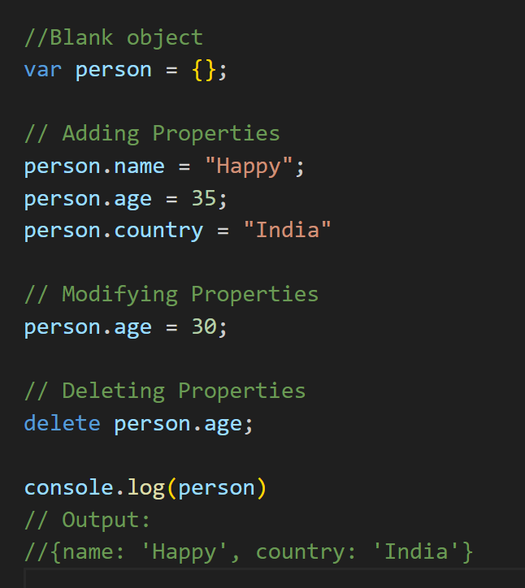
Q. How do you add or modify or delete properties of an object?
back to chapter index
Notes:
//Blank object
var person = {};
// Adding Properties
person.name = "Happy";
person.age = 35;
person.country = "India"
// Modifying Properties
person.age = 30;
// Deleting Properties
delete person.age;
console.log(person)
// Output:
//{name: 'Happy', country: 'India'}

Slide 29
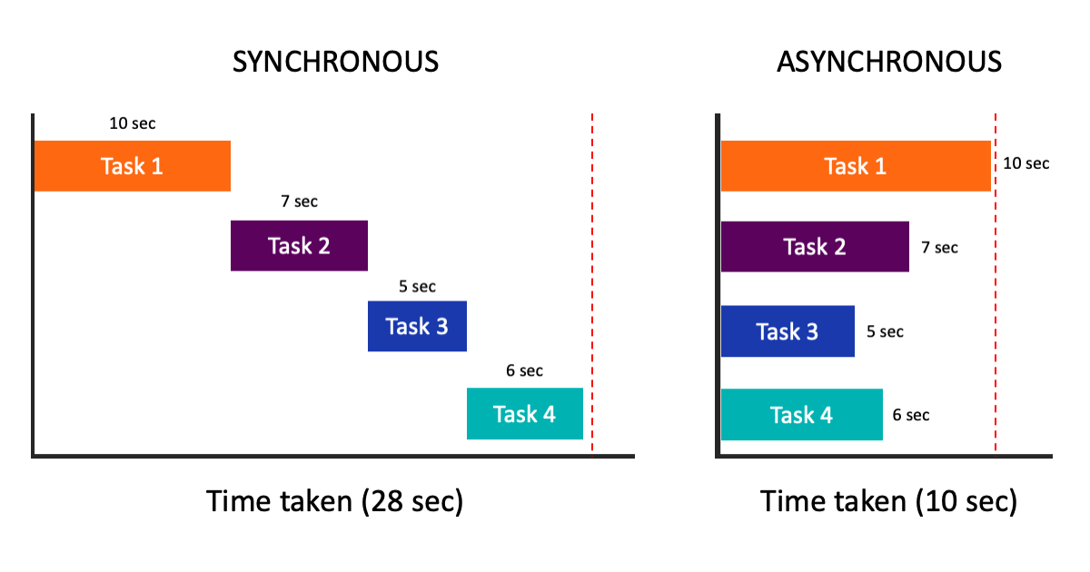
Q. What is asynchronous programming in JS? What is its use?
back to chapter index

Slide 30
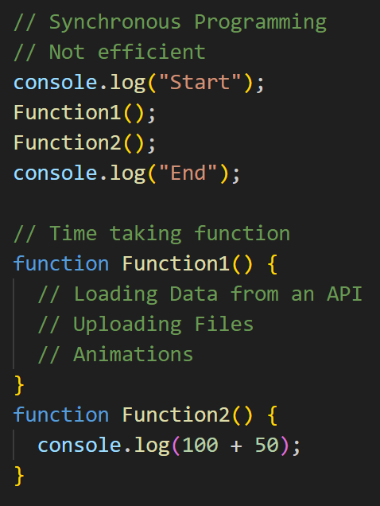
Q. What is asynchronous programming in JS? What is its use?
Asynchronous programming allows multiple tasks or operations to be initiated and executed concurrently.
Asynchronous operations do not block the execution of the code.
Use of Asynchronous Operations
Fetching Data from API
Time taking operations…
Downloading Files
Uploading Files
Animations and Transitions
back to chapter index
Notes:
console.log("Start");
Function1();
Function2();
console.log("End");
// Time taking function
function Function1() {
// Loading Data from an API
// Uploading Files
// Animations
}
function Function2() {
console.log(100 + 50);
}

Slide 31



Q. What is the difference between synchronous and asynchronous programming?
back to chapter index

Slide 32


Q. What are Promises in JavaScript?
Important points about promises:
Promises in JavaScript are a way to handle asynchronous operations.
A Promise can be in one of three states: pending, resolved, or rejected.
A promise represents a value that may not be available yet but will be available at some point in the future.
back to chapter index

Slide 33

Q. How to implement Promises in JavaScript?
resolve()
reject()
back to chapter index

Slide 34





Q. How to implement Promises in JavaScript?
back to chapter index

Slide 35


Q. Explain the use of async and await keywords in JS?
The async keyword is used to define a function as an asynchronous function, which means the code inside async function will not block the execution other code.
The await keyword is used within an async function to pause the execution of the function until a Promise is resolved or rejected.
back to chapter index
Notes:
function delay(ms) {
return new Promise((resolve) => {
setTimeout(() => {
resolve("Running");
}, ms);
});
}
async function greet() {
console.log("Starting...");
const result = await delay(1000);
console.log(result);
console.log("Not blocked");
}
greet();

Slide 36

Q. What are Classes in JS?
Classes serve as blueprints for creating objects and define their structure and behavior.
Advantages of classes:
  Object Creation
  Encapsulation
  Inheritance
  Code Reusability
  Polymorphism
  Abstraction
back to chapter index
Notes:
// class example
class Person {
constructor(name, age) {
this.name = name;
this.age = age;
}
sayHello() {
console.log(`${this.name} - ${this.age}`);
}
}
// Creating objects from the class
var person1 = new Person("Alice", 25);
var person2 = new Person("Bob", 30);
// Accessing properties and calling methods
console.log(person1.name); // Output: "Alice"
person2.sayHello(); // Output: "Bob - 30"

Slide 37
Q. What is a constructor?
Constructors are special methods within classes that are automatically called when an object is created of the class using the new keyword.
back to chapter index

Slide 38


Q. What is the use of this keyword?
this keyword provides a way to access the current object or class.
back to chapter index
Notes:
// class example
class Person {
constructor(name) {
this.name = name;
}
sayHello() {
console.log(`${this.name}`);
}
}
var person1 = new Person("Happy")
console.log(person1.name);
// constructor function
function Person(name, age) {
this.name = name;
this.age = age;
}
// Object
var person = {
name: "Alice",
sayHello: function () {
console.log(this.name);
},
};

Slide 39

All the best for your projects
Never ever give up
FEDF TEAM KLH Bachupally

